Slide 1
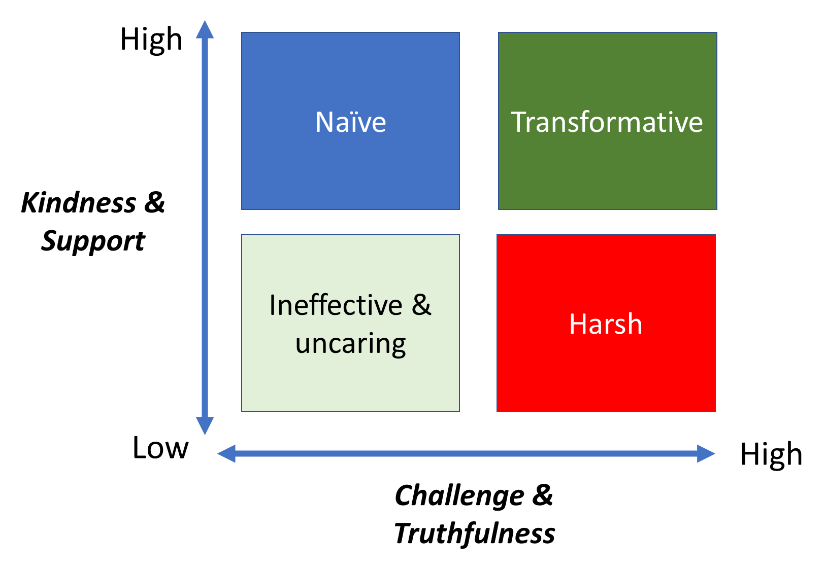
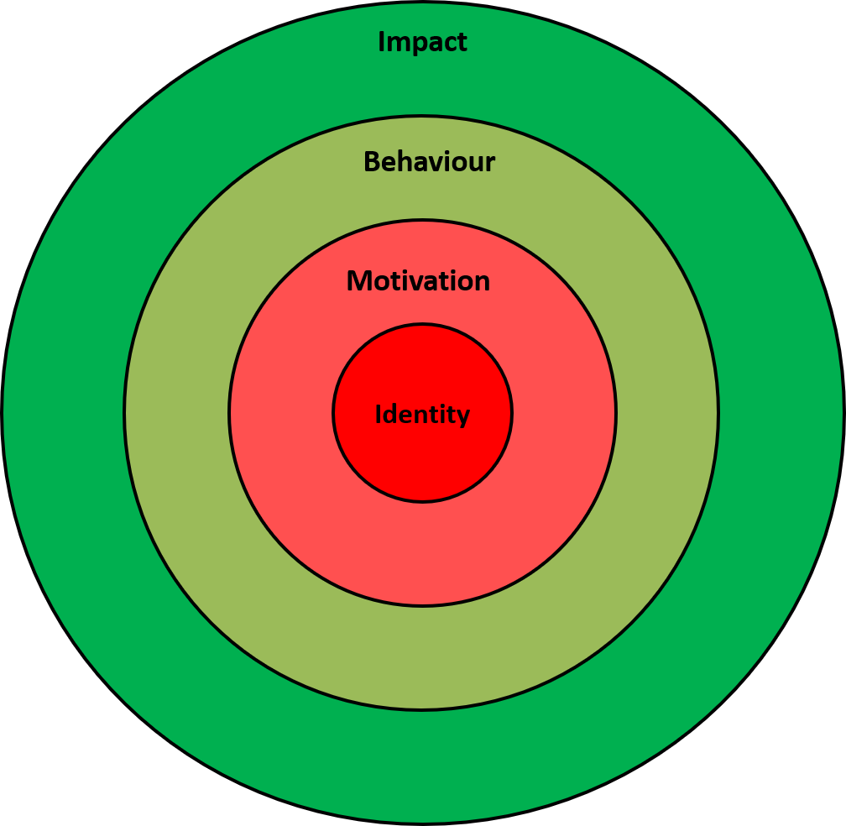
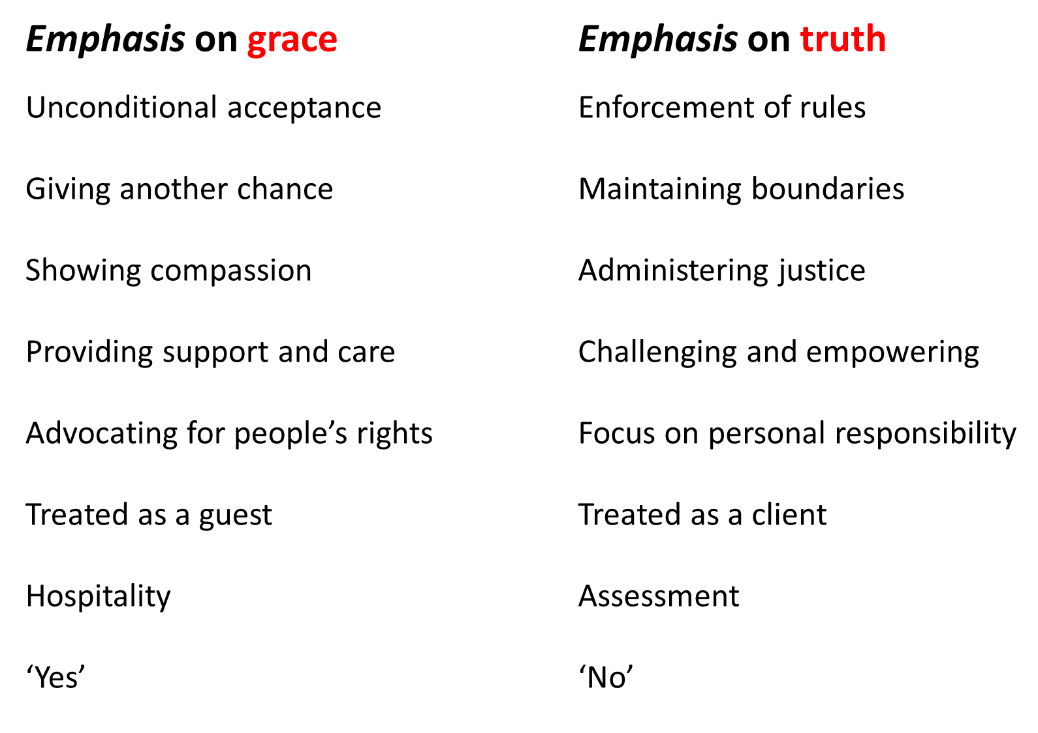
Tools for
Truth-telling
“Simply let your ‘yes’ be ‘yes’ and your ‘no’,‘no.’
(Matt 5:37)
Jon Kuhrt gracetruth.blog
Focus on…
Behaviour: what has been done or not done
Impact: the consequences that this behaviour has had
Avoid speculation on….
Motivation: the reasons why they act in this way
Identity: who they are as a person
This target model was developed by Adrian Lock, Director of Deeper Leaders www.deeperleaders.com
Notes:
Jon

