Slide 1
Grace, truth and people management
Jon Kuhrt
www.gracetruth.blog

Slide 2
High
Naïve
Transformative
Kindness & Support
Ineffective & uncaring
Harsh
Low
High
Challenge & Truthfulness
Jon Kuhrt
www.gracetruth.blog

Slide 3
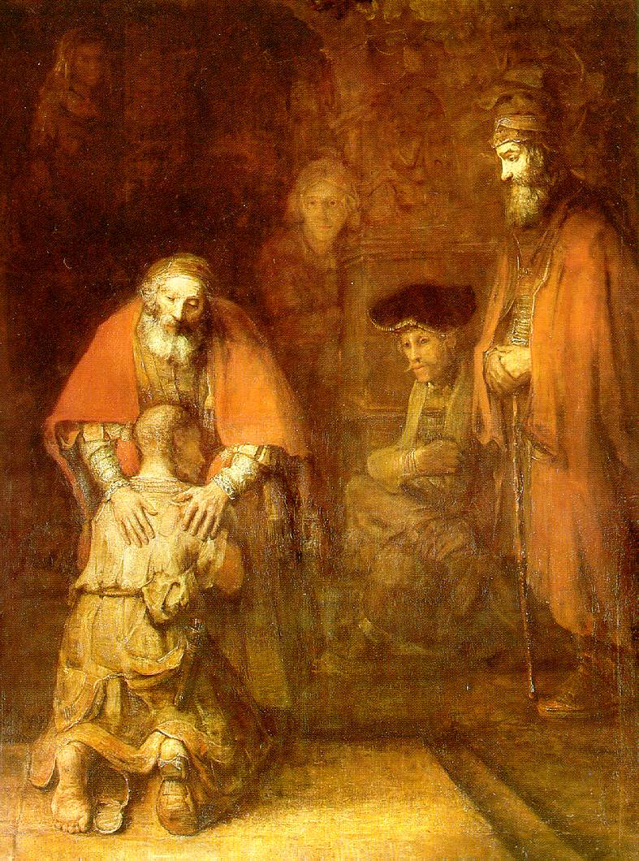
Grace…
“But while he was still a long way off, his father saw him and was filled with compassion for him; he ran to his son, threw his arms around him and kissed him.”
….and truth
“When he came to his senses, he said, ‘How many of my father’s hired servants have food to spare, and here I am starving to death! I will set out and go back to my father and say to him: Father, I have sinned against heaven and against you…’ So he got up and went to his father.”
Luke 15:11-31 & The Return of the Prodigal Son by Rembrandt (1669)

Slide 4
Emphasis on grace | Emphasis on truth
Support | Challenge
Kindness | Empowerment
Flexibility | Consistency
Giving another chance | Maintaining boundaries
Appreciation | Accountability
Compassion | Justice
Saying ‘yes’ | Saying ‘no’
Jon Kuhrt
www.gracetruth.blog

